Slide 1
DIGITAL CLOCK AND STOPWATCH
GROUP 1
WASU SONTHICHAI (6238193221)
WICHAYAPORN RATANANENYA (6238195521)

Slide 2
TASK 1: DIGITAL CLOCK
Tracks time on LCD screen
Synchronizes to the real time
Blinks over clock frequency

Slide 3
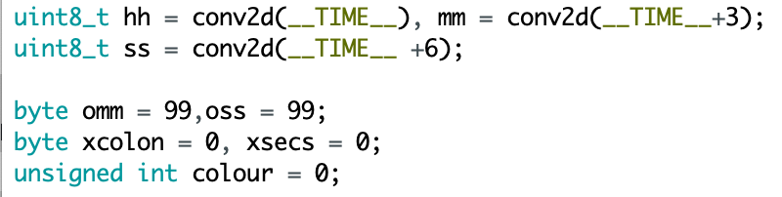
TASK 1: DIGITAL CLOCK
Code Snippets

Slide 4
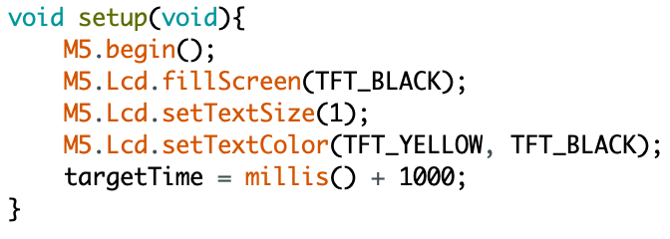
TASK 1: DIGITAL CLOCK
Code Snippets

Slide 5
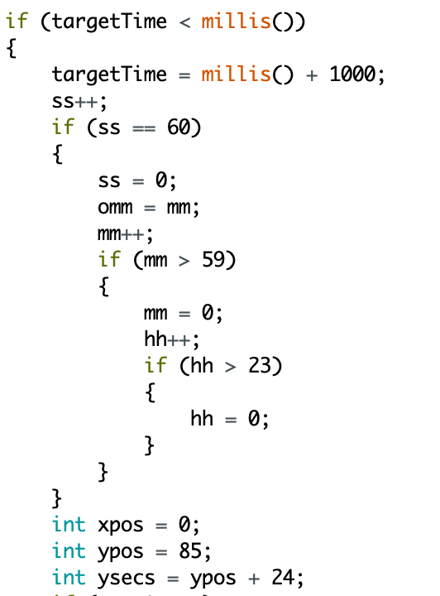
TASK 1: DIGITAL CLOCK
Code Snippets

Slide 6
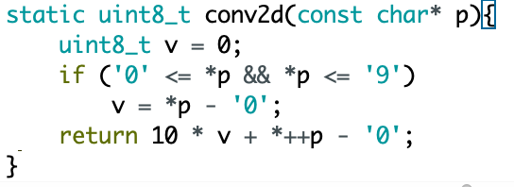
TASK 1: DIGITAL CLOCK
Code Snippets

Slide 7
TASK 2: STOP WATCH
1/100th second accuracy (10ms per tick)
Stopwatch functionality:
- Button A = START
- Button B = PAUSE
- Button C = RESET

Slide 8
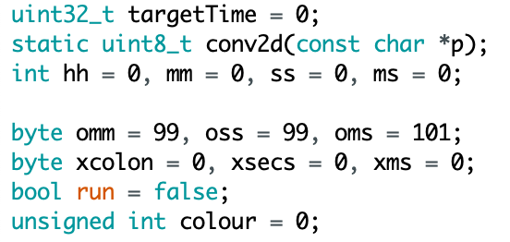
TASK 2: STOP WATCH
Code Snippets

Slide 9
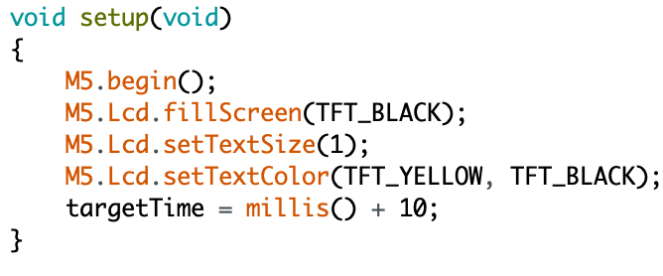
TASK 2: STOP WATCH
Code Snippets

Slide 10
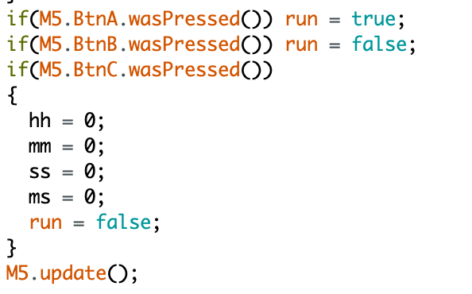
TASK 2: STOP WATCH
Code Snippets

Slide 11
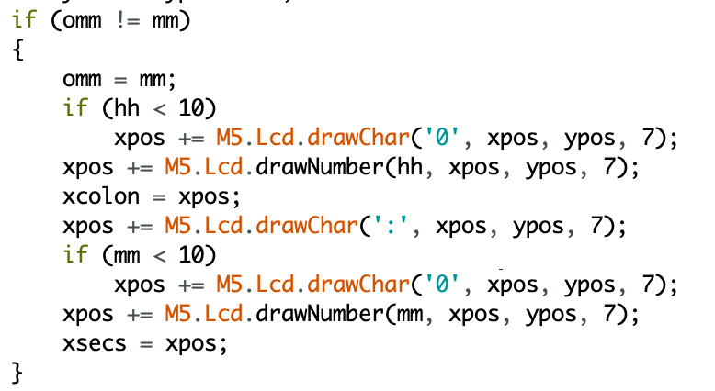
TASK 2: STOP WATCH
Code Snippets

Slide 12
printf(“Thank you.”);

